Slide 1
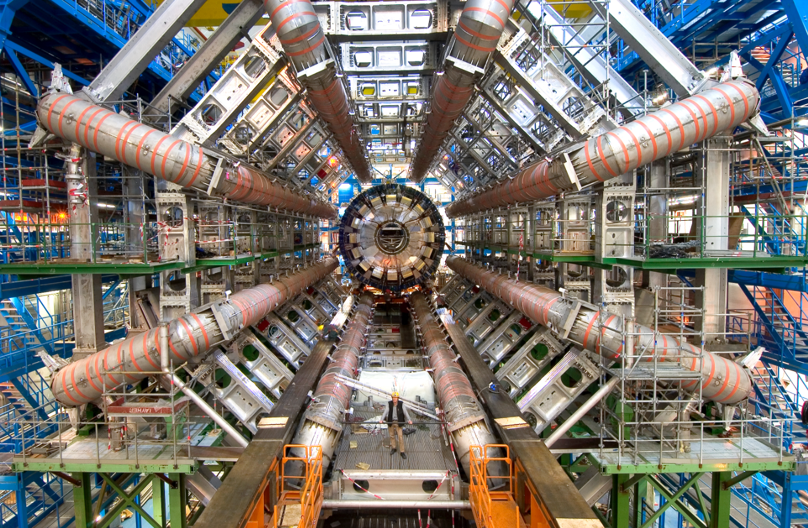
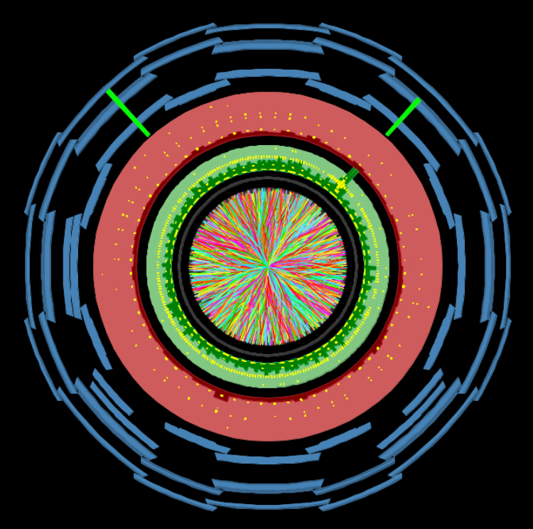
Search for Supersymmetry at ATLAS Run 1
and physics potential of the HL-LHC
Argonne National Laboratory
March 4th 2015
Anadi Canepa | TRIUMF

Slide 2
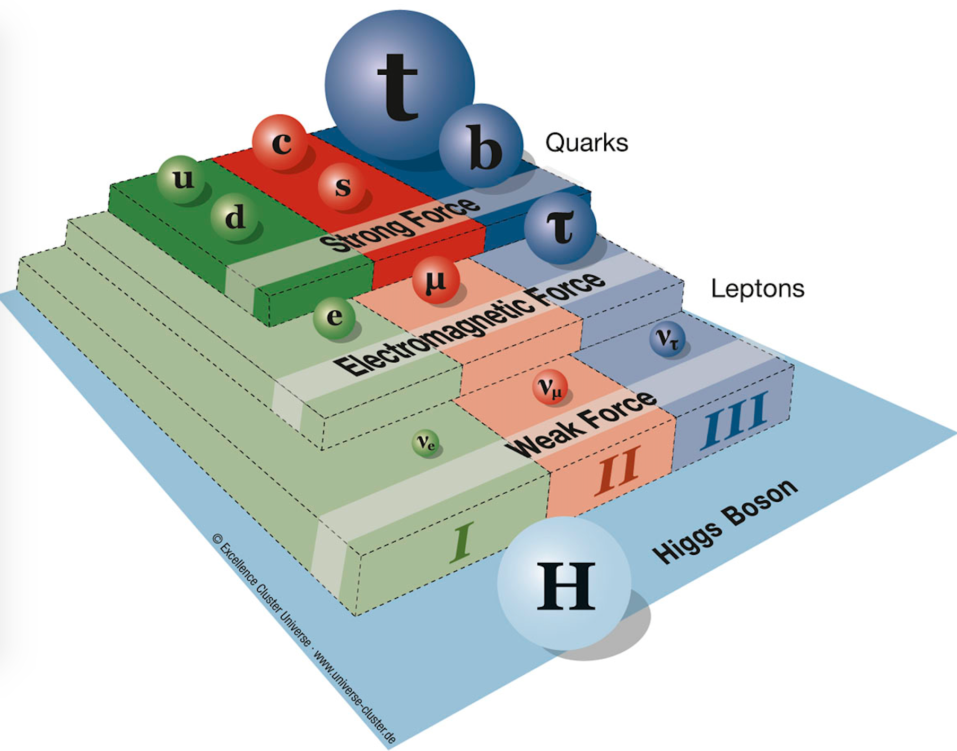
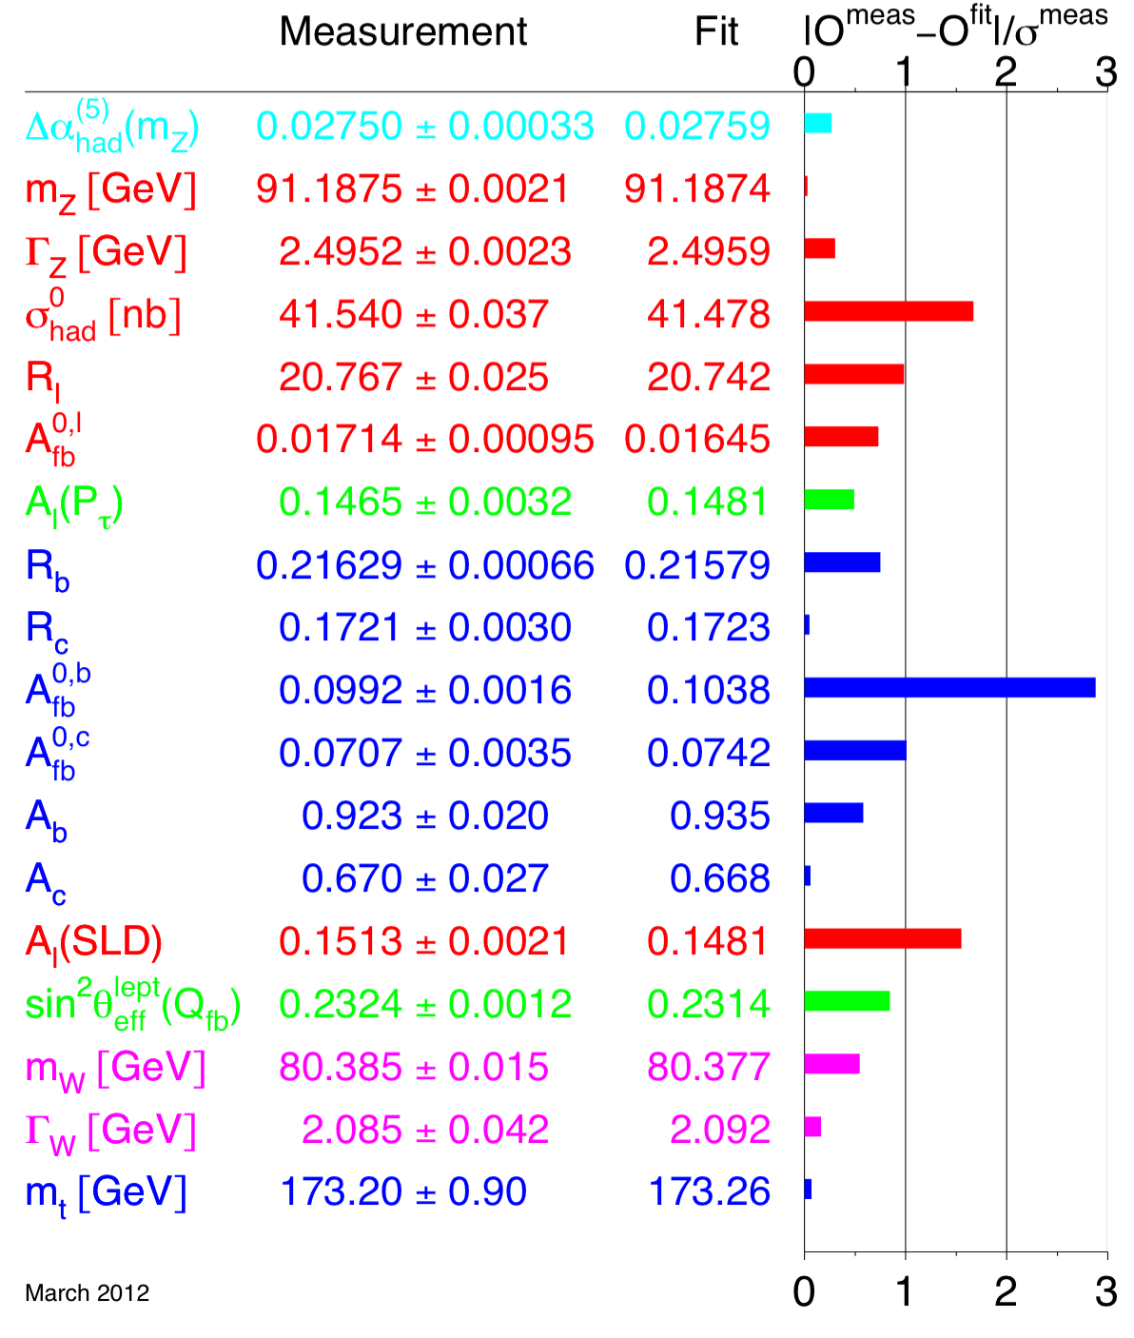
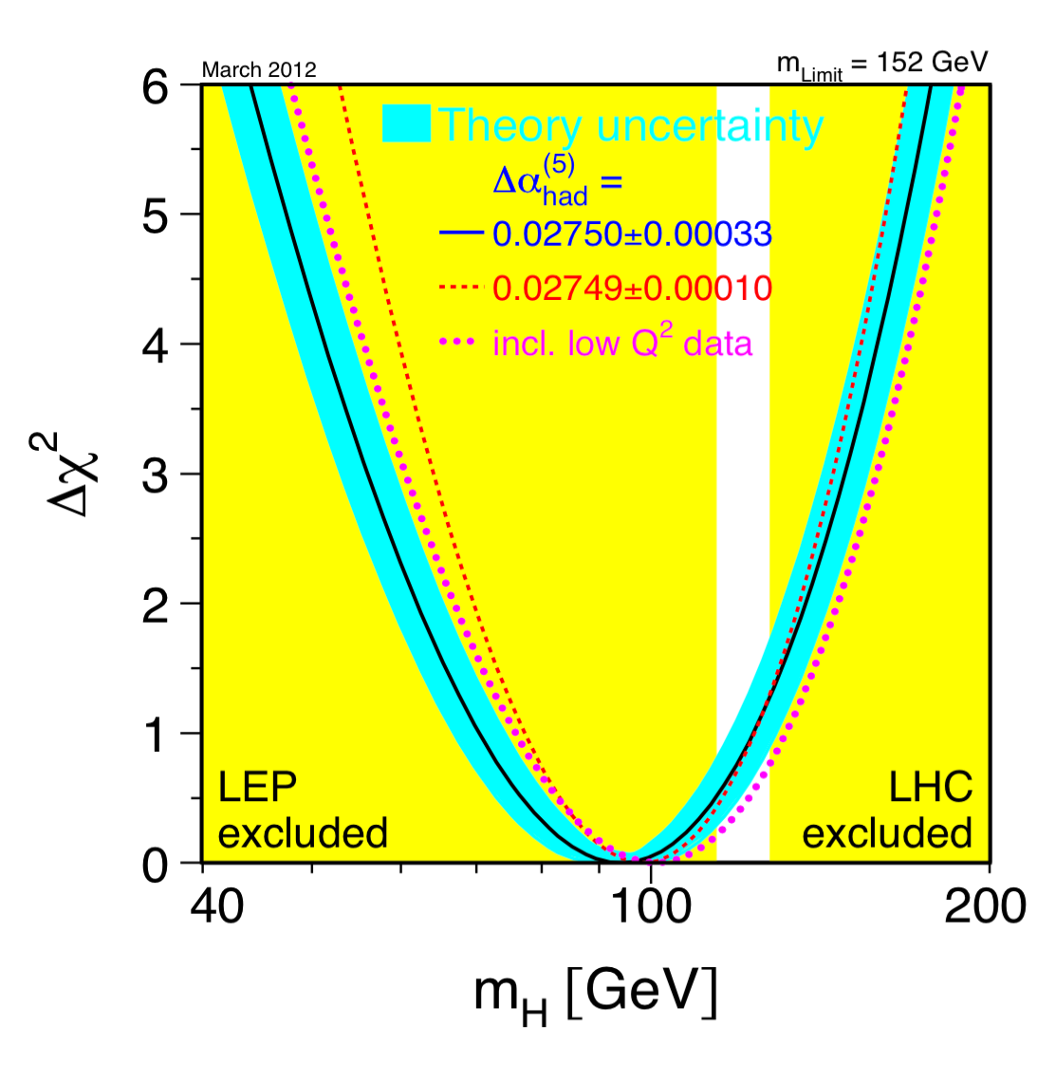

The Standard Model prior to July 2012
Standard Model (SM) is a quantum field theory based on gauge symmetries
It predicts massless gauge bosons contradicting observation of massive W and Z
The Higgs mechanism was introduced to give mass to all particles while preserving gauge symmetry
SM is tested at the per mill level and fit to precision data provides constraints on the Higgs mas
Notes:
Elementary particles and their interactions are described with the SM which is a QFT based on gauge symmetries…..

Slide 3
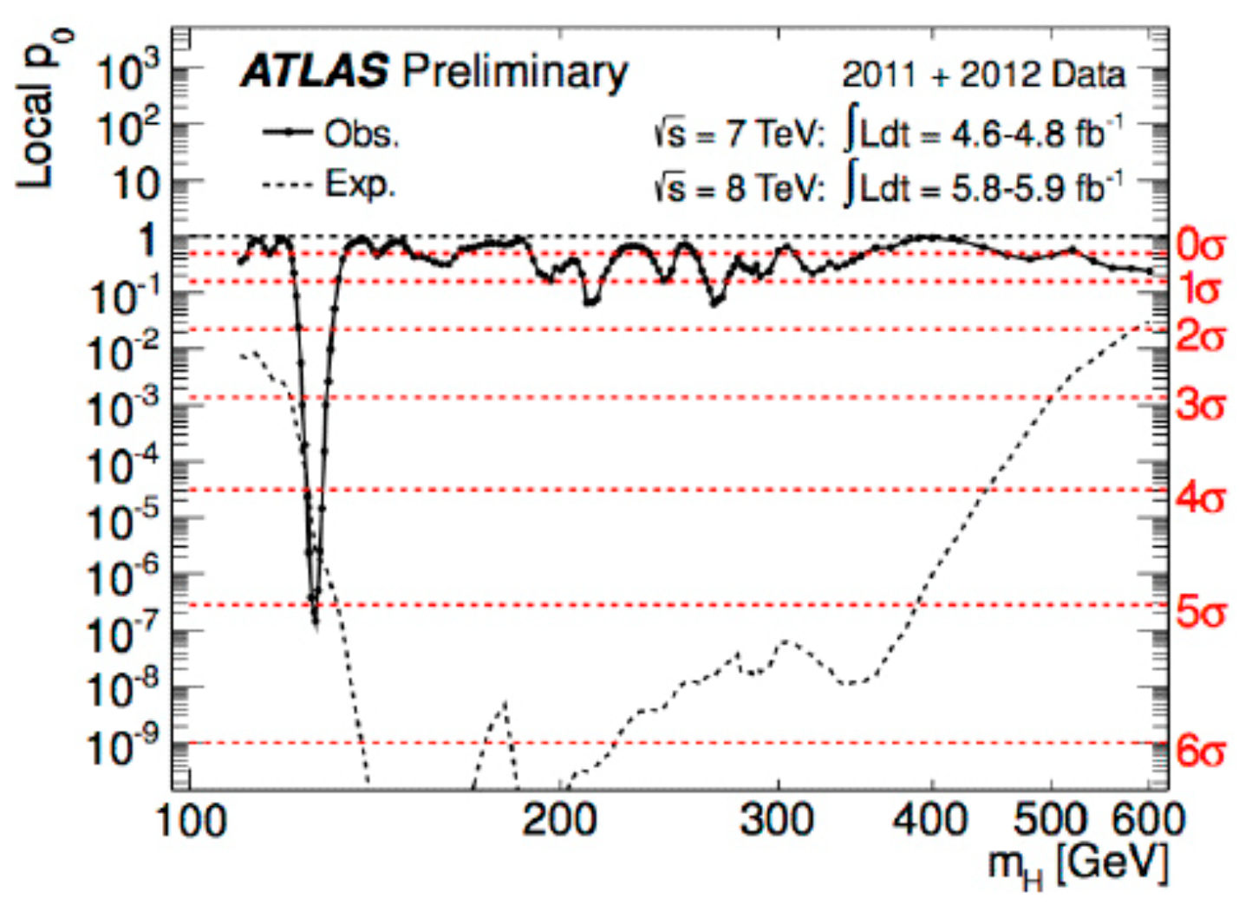
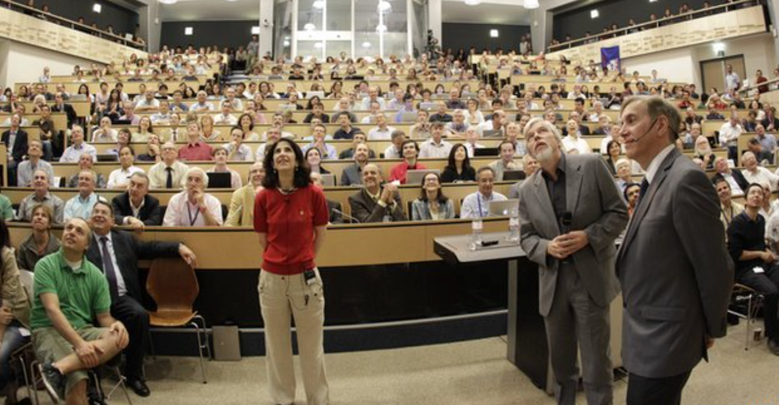
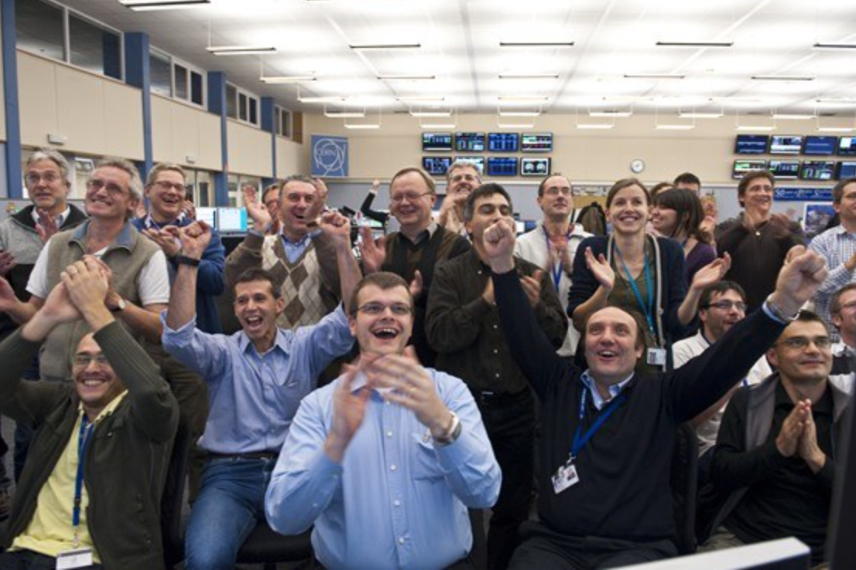

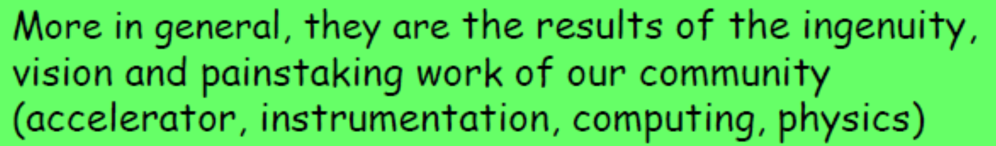
2012, Historical Year in Particle Physics

Slide 4
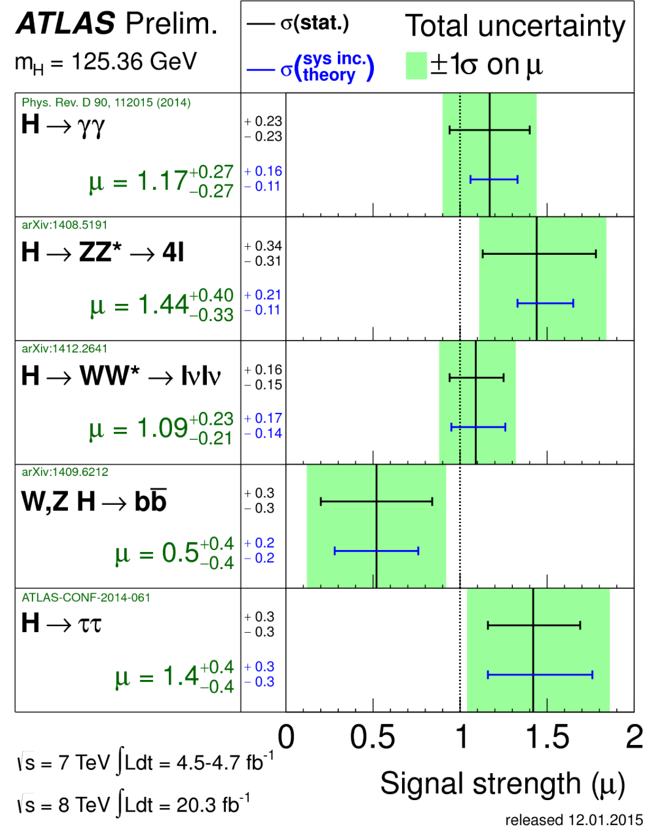


“Higgs-like”, ‘a’ Higgs, ‘the’ Higgs?
Based on the extraordinary program developed by both the ATLAS and CMS collaborations, it looks like we have discovered “the” Higgs boson
data provide evidence for the spin-0 nature of the boson, with positive parity being strongly preferred
The SM is now a UV complete theory of strong, weak, and EM forces possibly valid till the Plank scale
Mass of the Higgs
m_{H} = 125.36±0.37_{stat}±0.18_{sys} GeV
Width of the Higgs
4.8 < ΓH/ΓSMH <7 .7 (95%CL)
ATLAS-CONF-2014-042
1406.3827
Notes:
Th total uncertainty on the mass measurement from the photon energy scale uncertainties ranges from 0.17% to 0.57% depending on the category. mH = 125.98 ± 0.42(stat) ± 0.28(syst) GeV = 125.98 ± 0.50 GeV
HZZ
mH = 124.51 ± 0.52 (stat) ± 0.06 (syst) GeV = 124.51 ± 0.52 GeV
are the electron energy scale and the muon momentum scale.
With respect to the previously published value [15] of mH = 125.49 ± 0.24 (stat)+0.50 (syst) GeV, the observed −0.58
statistical error has increased. This is due to the increase of the observed statistical error in the H → γγ channel as discussed in Sec. 4.7. The systematic uncertainty is significantly reduced thanks to the improvements in the calibration of the photons and electrons and the reduction in the uncertainty on the muon momentum scale,
∆mH =1.47±0.67(stat)±0.28(syst)GeV = 1.47 ± 0.72 GeV
compatibility of 4.9% is obtained, corresponding to 1.97σ.
Upper limit on the width
In the H → γγ channel, a 95% CL limit of 5.0 (6.2) GeV is observed (expected). In the H→ ZZ∗→ 4l channel, a 95% CL limit of 2.6 (6.2) GeV is observed (expected).
The off-shell Higgs boson signal cannot be treated independently from the gg → ZZ background, as sizeable negative interference effects appear
The combination of both on- and off-shell measure- ments promises a significantly higher sensitivity to the total width ΓH than previously believed possible at the LHC through direct measurements of the on-shell line shape.

Slide 5
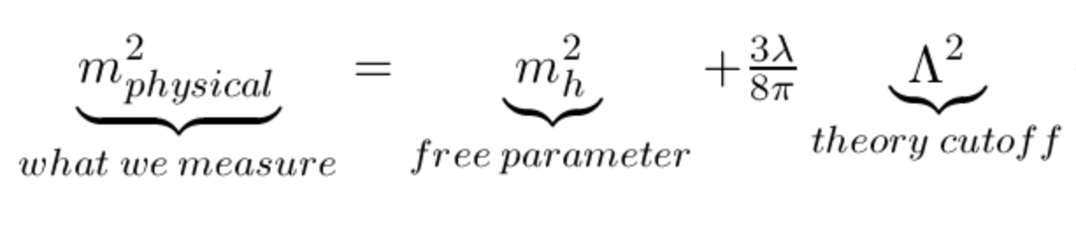
“Higgs-like”, ‘a’ Higgs, ‘the’ Higgs?
Based on the extraordinary program developed by both the ATLAS and CMS collaborations, it looks like we have discovered “the” Higgs boson
data provide evidence for the spin-0 nature of the boson, with positive parity being strongly preferred
The SM is now a UV complete theory of strong, weak, and EM forces possibly valid till the Plank scale
However, it poses a fine tuning problem
Mass of the Higgs
m_{H} = 125.36±0.37_{stat}±0.18_{sys} GeV
Width of the Higgs
4.8 < ΓH/ΓSMH <7 .7 (95%CL)
ATLAS-CONF-2014-042
1406.3827

Slide 6
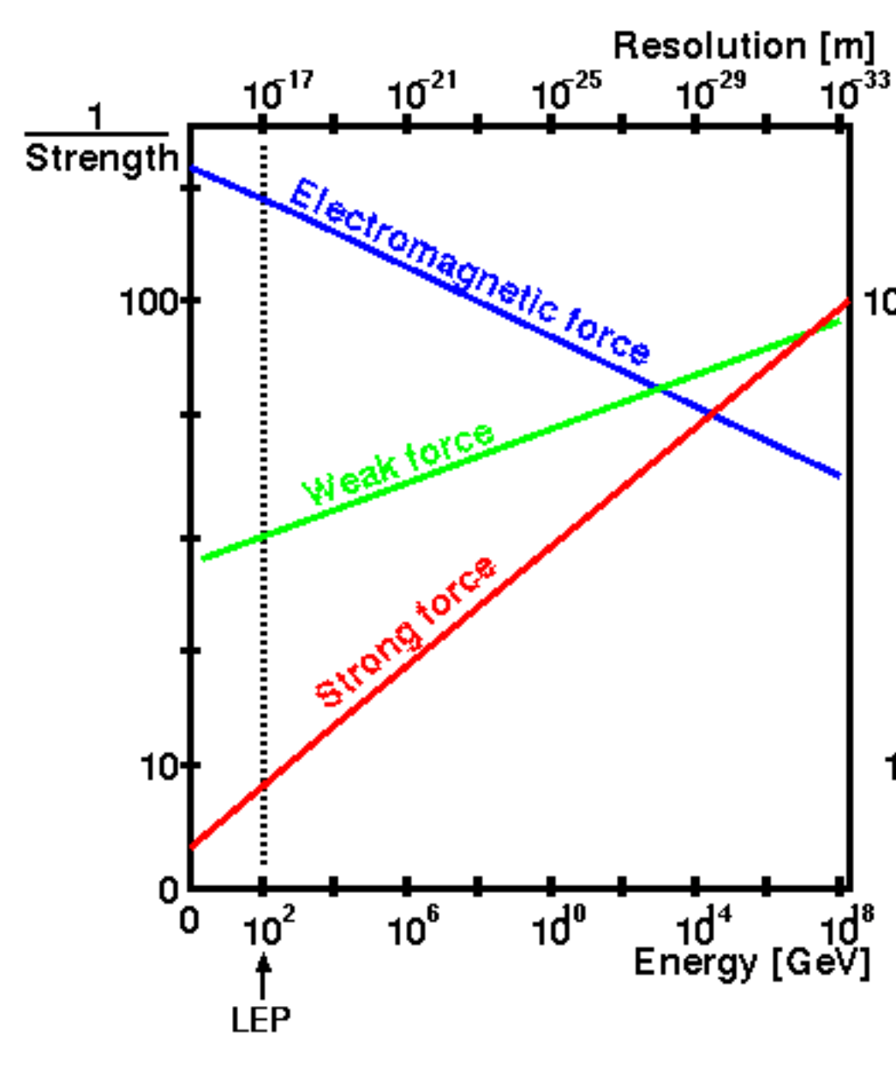
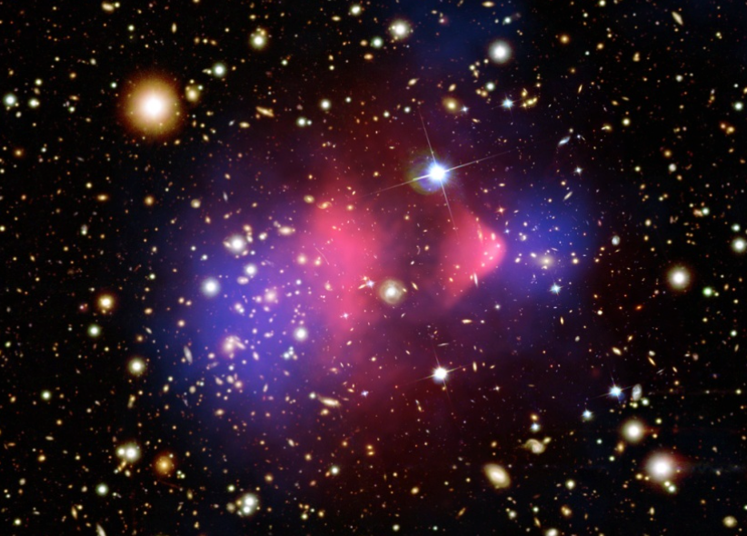
More Fundamental Questions yet to Answer
In the Standard Model gauge interactions to do not unify
There is now strong evidence that baryonic matter is not all the matter in the Universe:
Dark Matter: 23% ± 4%
Dark Energy: 73% ± 4%
Normal Matter: 4% ± 0.4%
Neutrinos: 0.2% (Σmν/0.1eV)
Origin of flavor is unknown
Origin of CP violation is unknown
More …

Slide 7
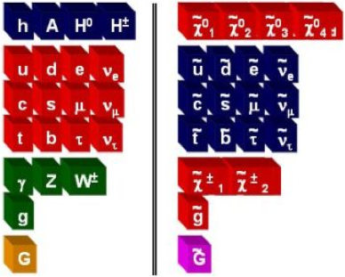

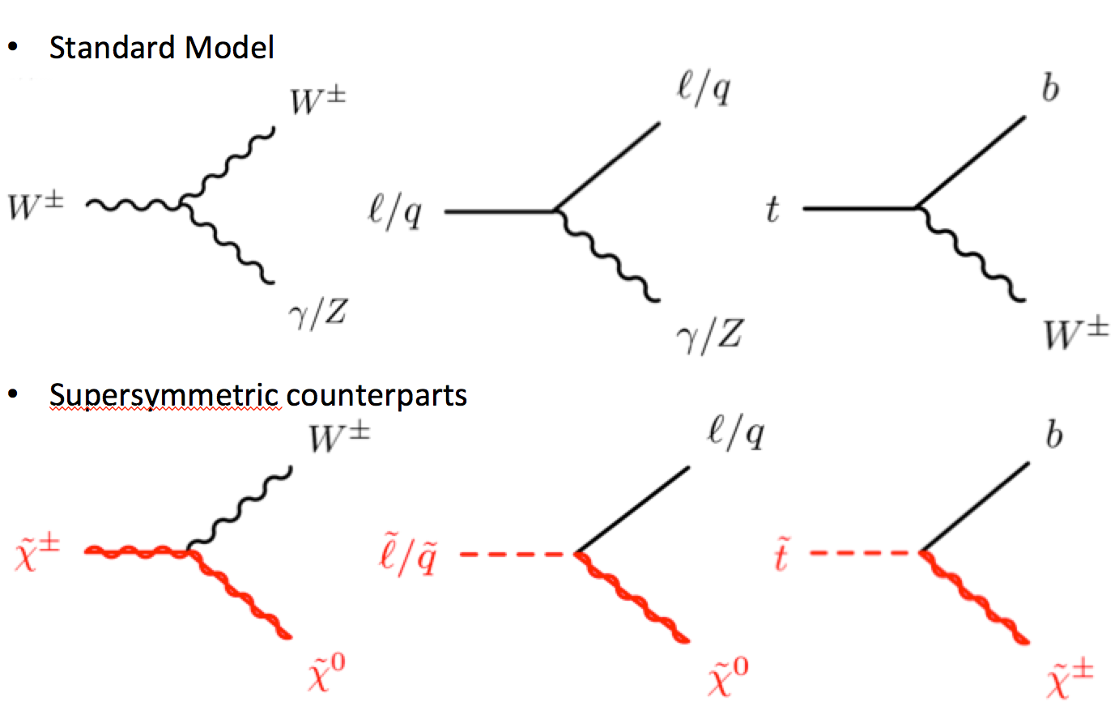
SuperSymmetry in 60 secs.
SM Fermion (boson) ↔︎ boson (fermion)
Spin 0
squarks, sleptons, sneutrinos
Spin 1/2
charginos and neutralinos
gluinos
gravitinos
Lightest neutralino is typically the lightest SUSY particle (LSP) and is stable
Notes:
(SUSY —> CP Violation. flavor.)

Slide 8
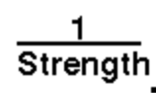
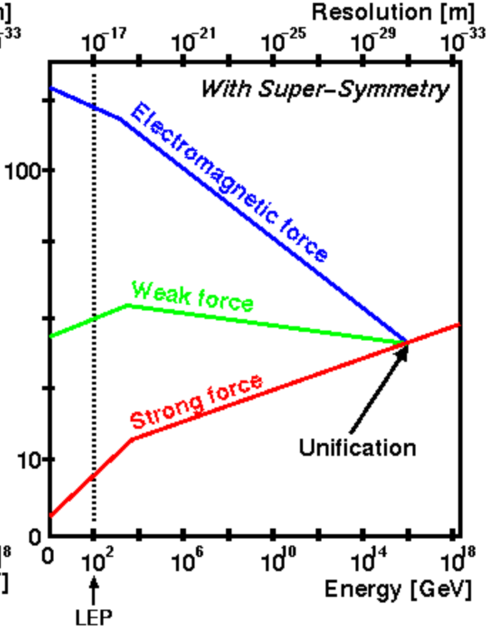
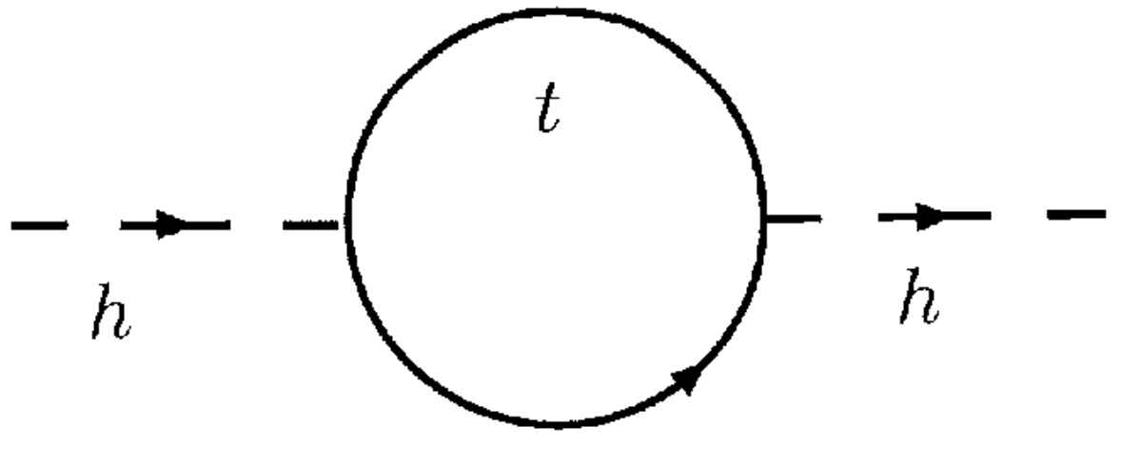
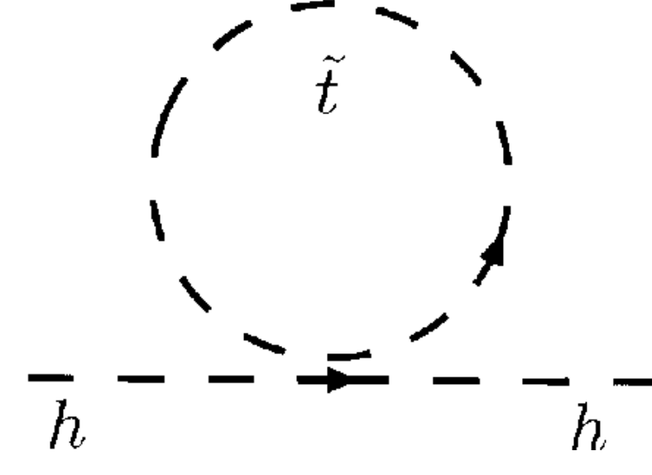
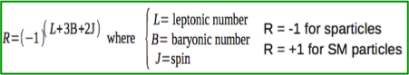
Why SUSY?
SuperSymmetry
is the only mathematically viable extension of the Poincare space-time symmetry
provides a connection to gravity
leads to the unification of gauge interactions
includes radiative EWKSB
SUSY loops make mH² negative
expects the Higgs mass to be below 135 GeV
ΔmH² ~ m²SUSYlog(Λ)
predicts an excellent candidate for Dark Matter if R-parity is conserved
SUSY breaking makes SUSY particle mass different than that of the SM partners
Notes:
Aesthetic considerations:
Supersymmetry is appealing from the mathematical point of view as an extension of Poincare space-time symmetry, and a surprisingly unique one as it happens. In physicist’s terms, in Nature we observe fields which transform as scalars, spinors or vectors under the Lorentz algebra. We also observe conserved charges which transform as Lorentz scalars (such as gauge charges) or as a Lorentz vector (energy- momentum). Conserved charges are associated with continuous symmetries, by Noether’s theorem: gauge charges with gauge symmetries, and energy-momentum with translational symmetry. It seems natural to ask if a conserved charge can also transform as a spinor, and what kind of symmetry a conserved spinorial charge would generate. The answer turns out to be supersymmetry.
Experimental considerations:

Slide 9
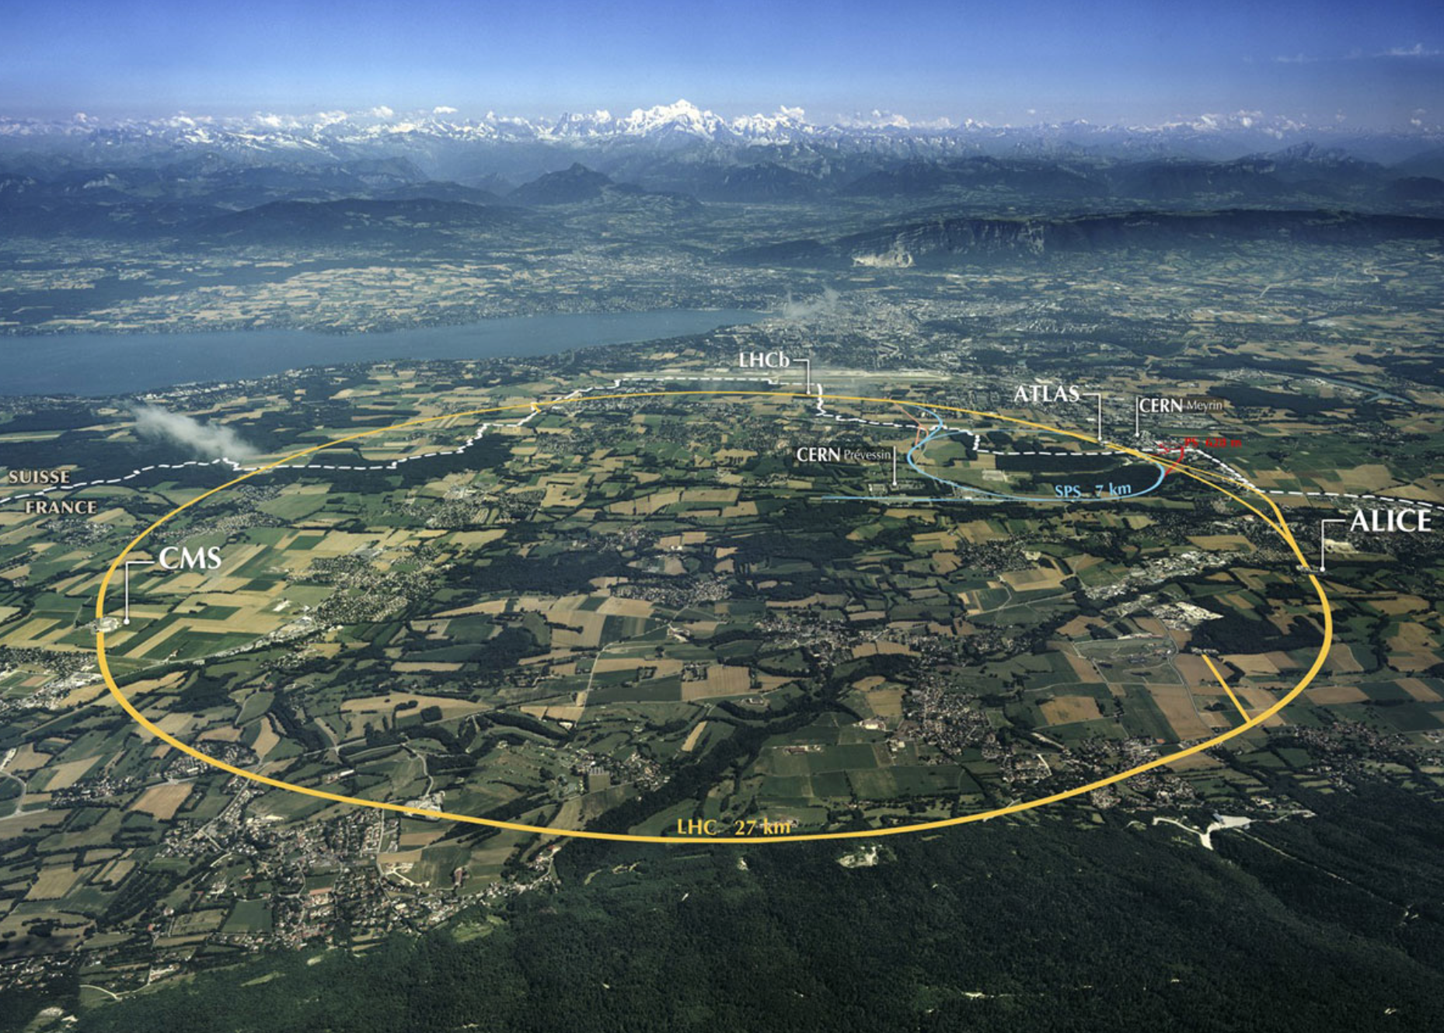
The Large Hadron Collider
Superconducting Proton Accelerator and Collider installed in a 27km circumference underground tunnel (tunnel was built for LEP collider in 1985)
 | Design | Run 1
Beam | 7 TeV | 3.5-4TeV
Intensity | 1.15E+11 | 1.48E+11
# bunches | 2808 | 1380
spacing | 25ns | 50ns
Luminosity | E34/cm²/s | 6.8E33/cm²/s
Notes:
The path for discovery of new particles by producing them in the laboratory is through high-energy colliders like the LHC.

Slide 10
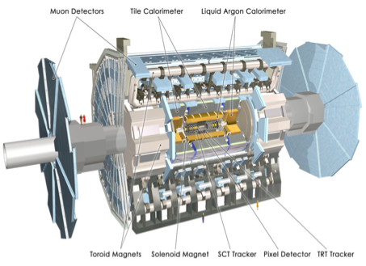
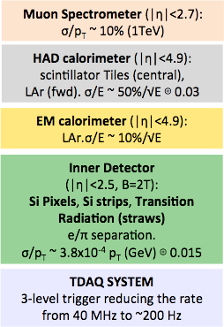
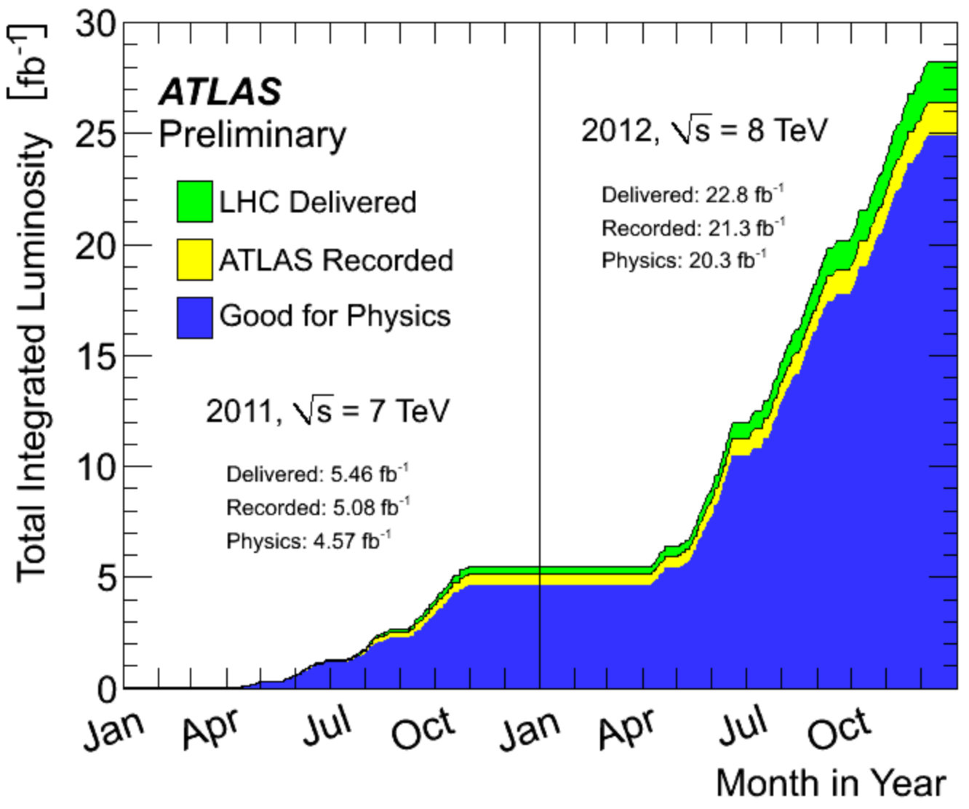
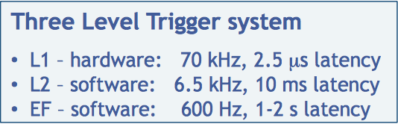
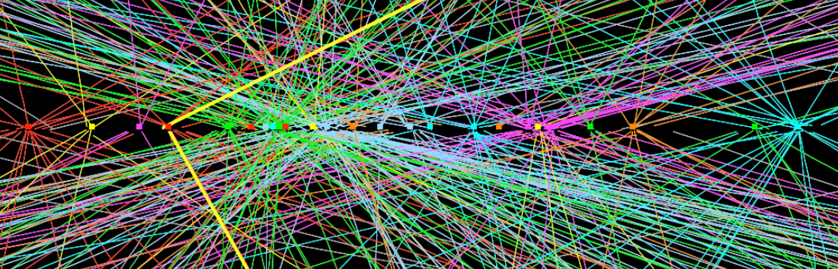
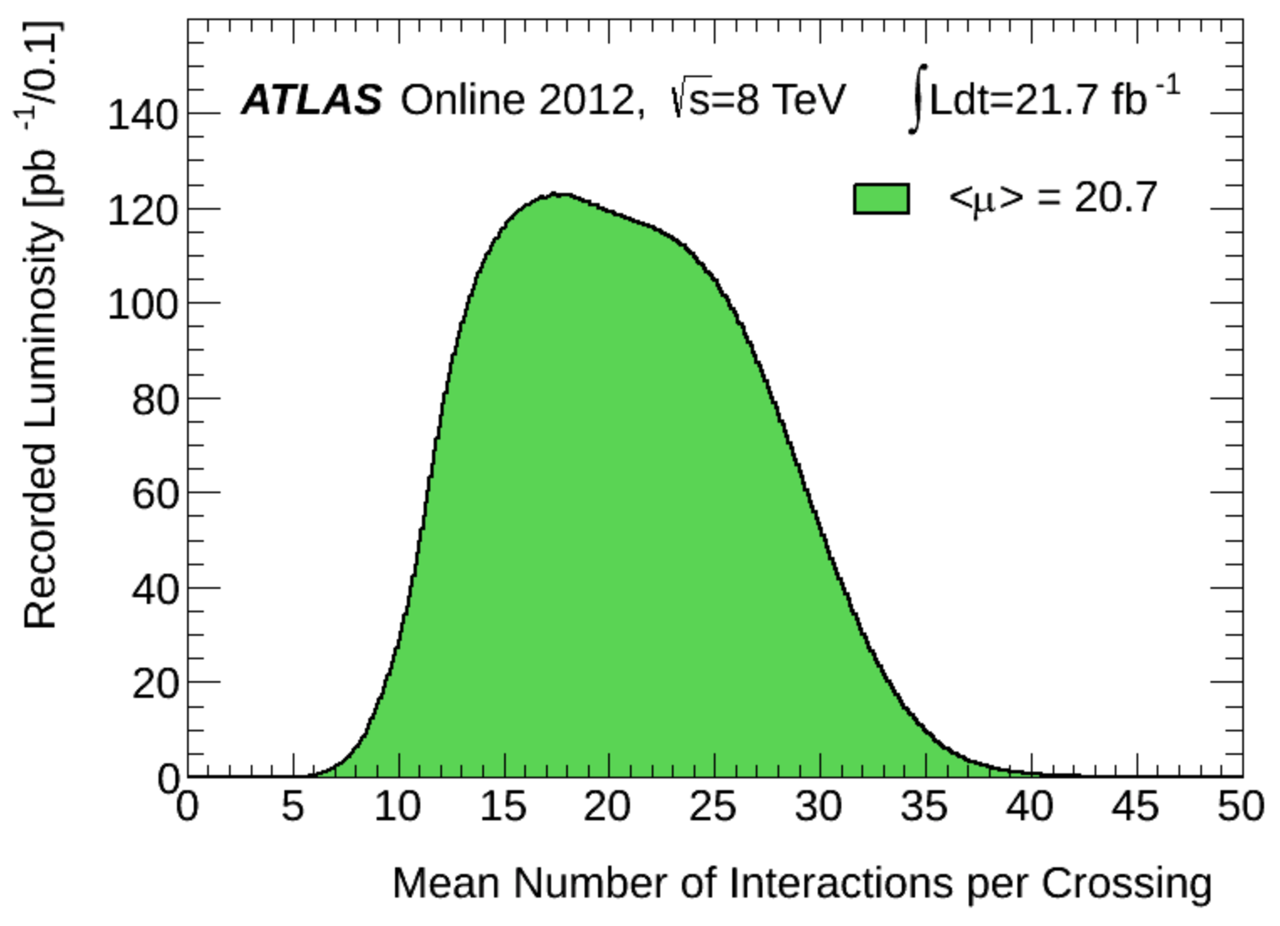
The ATLAS Detector
Excellent performance of the ATLAS detector during Run 1
including trigger, data processing, data handling and distributions, reconstruction, simulation,….

Slide 11
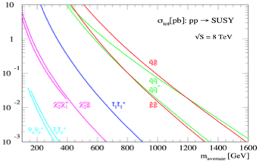

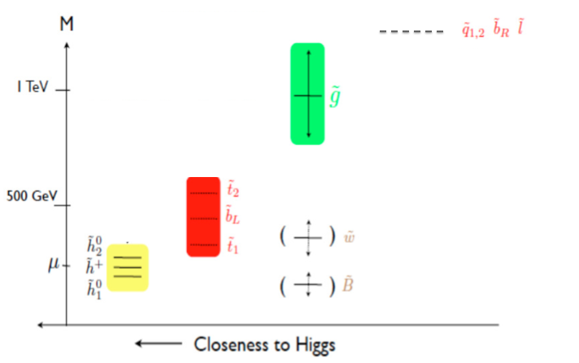
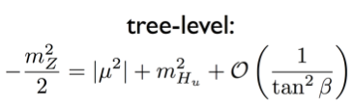
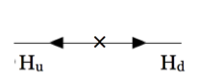
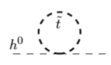
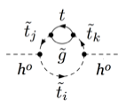
SUSY Search Strategy at ATLAS
The production cross-section depends on mass of sparticles and their interaction
for a given mass, we expect to achieve the largest sensitivity for strongly interacting SUSY
Theoretical arguments provide guidance to the search
NATURAL SUPERSYMMETRY

Slide 12
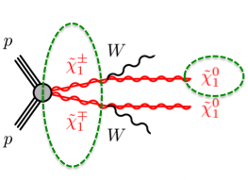
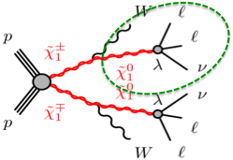
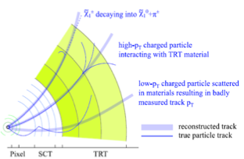
SUSY Signatures in ATLAS
The signature of the produced particles depend on:
Conservation of R-parity
sparticles are pair produced and decay into the LSP producing ETmiss
Violation of R-parity
LSP can decay into SM particles
sparticles can be singly produced (resonant signal)
Promptly decaying sparticles (like most SM particles)
Long lived sparticles
Lifetime is driven by the phase-space and propagator mass in RPC scenarios, and by the RPV couplings in RPV scenarios

Slide 13
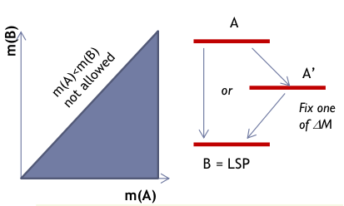
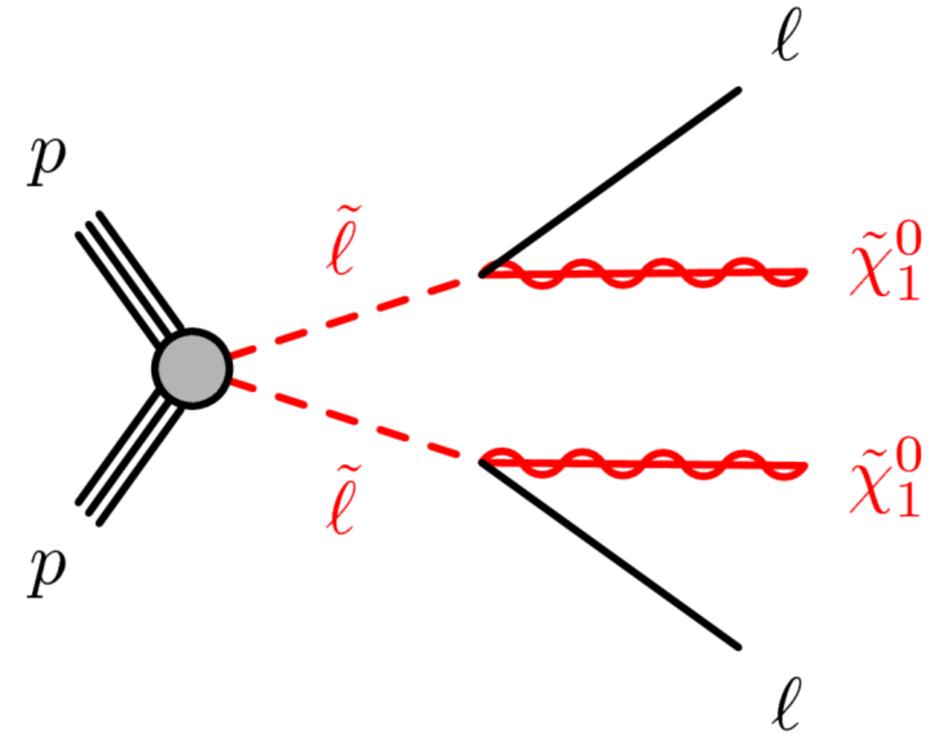
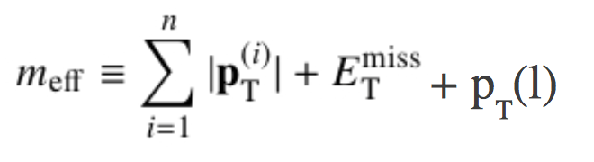
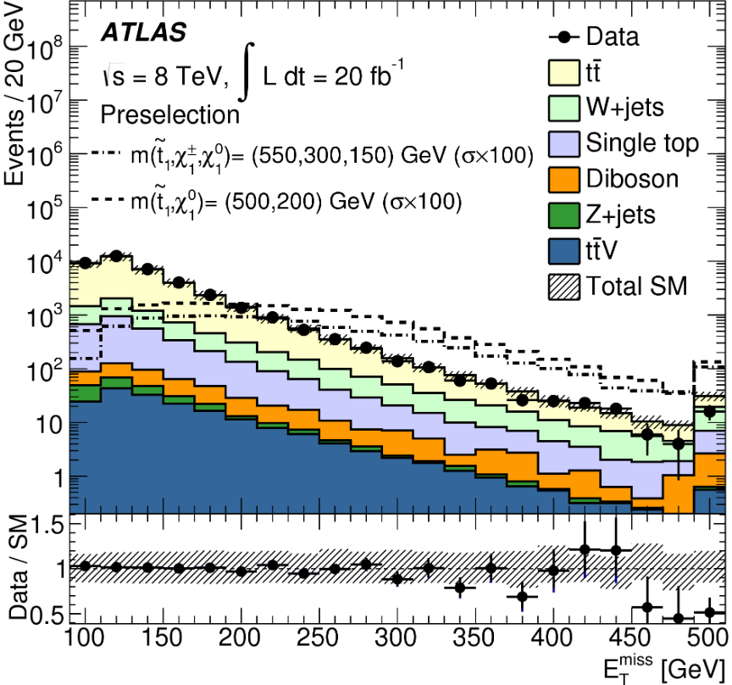
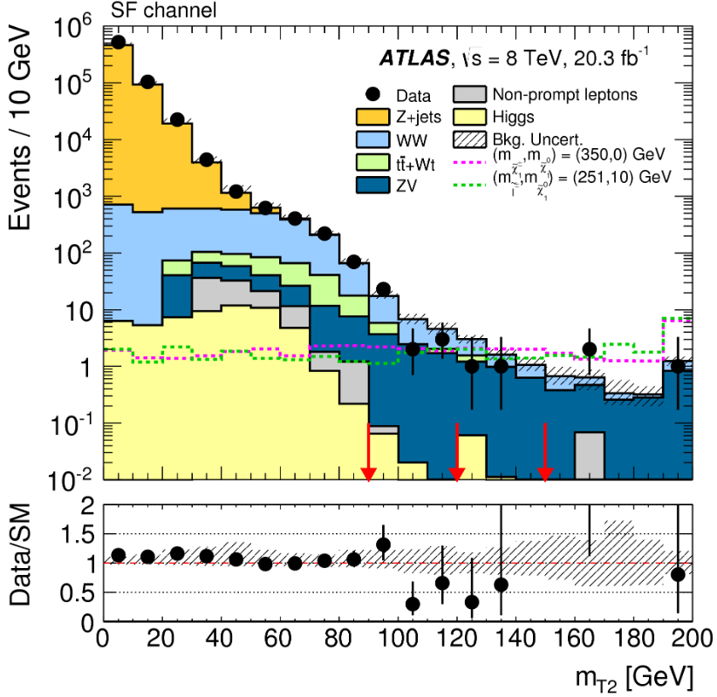
Signal vs Background
A (large) number of signal regions is optimized to discriminate signal and background based on predictions from simplified models, phenomenological models, full models
Discrimination based on kinematical and topological observables:
ETmiss for searches assuming RPC
MEff in searches for strongly produced particles
MT2 in searches with Ws from background or signal
….
Notes:
meff is correlated with the overall mass scale of the
hard-scatter interaction and provides good discrimination against SM background.

Slide 14
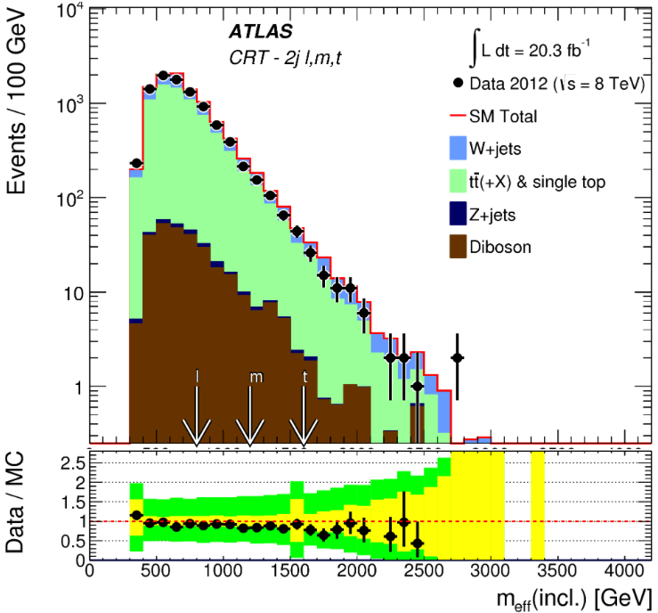


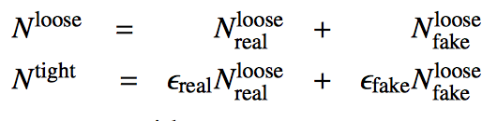

Modeling of Background
(The most) critical component of searches
Challenging as the signal is expected to manifest itself in the tails of the SM background
Monte Carlo Simulation
Semi-data driven
Normalization in control regions where each CR is dominated by a given source of background
Irreducible background
Data driven methods
‘Matrix Method’ for processes with hadrons/conversions mis-identified as leptons
‘Jet smearing’ for multijet and Z+j
Reducible background
Validation of Background estimates in dedicated samples (VRs)

Slide 15
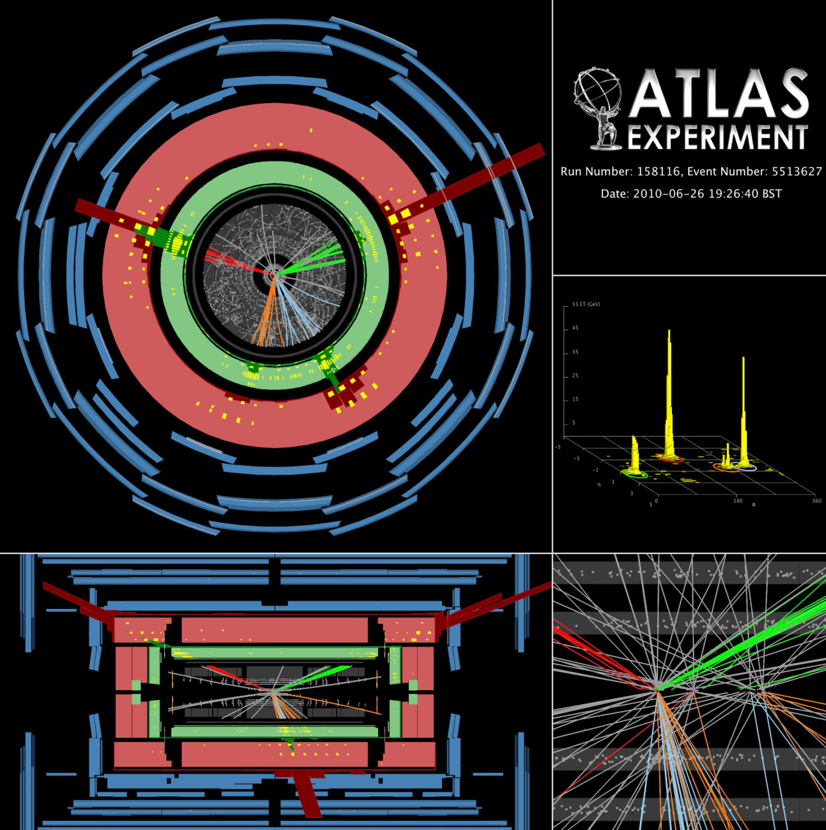
Search For Gluinos

Slide 16

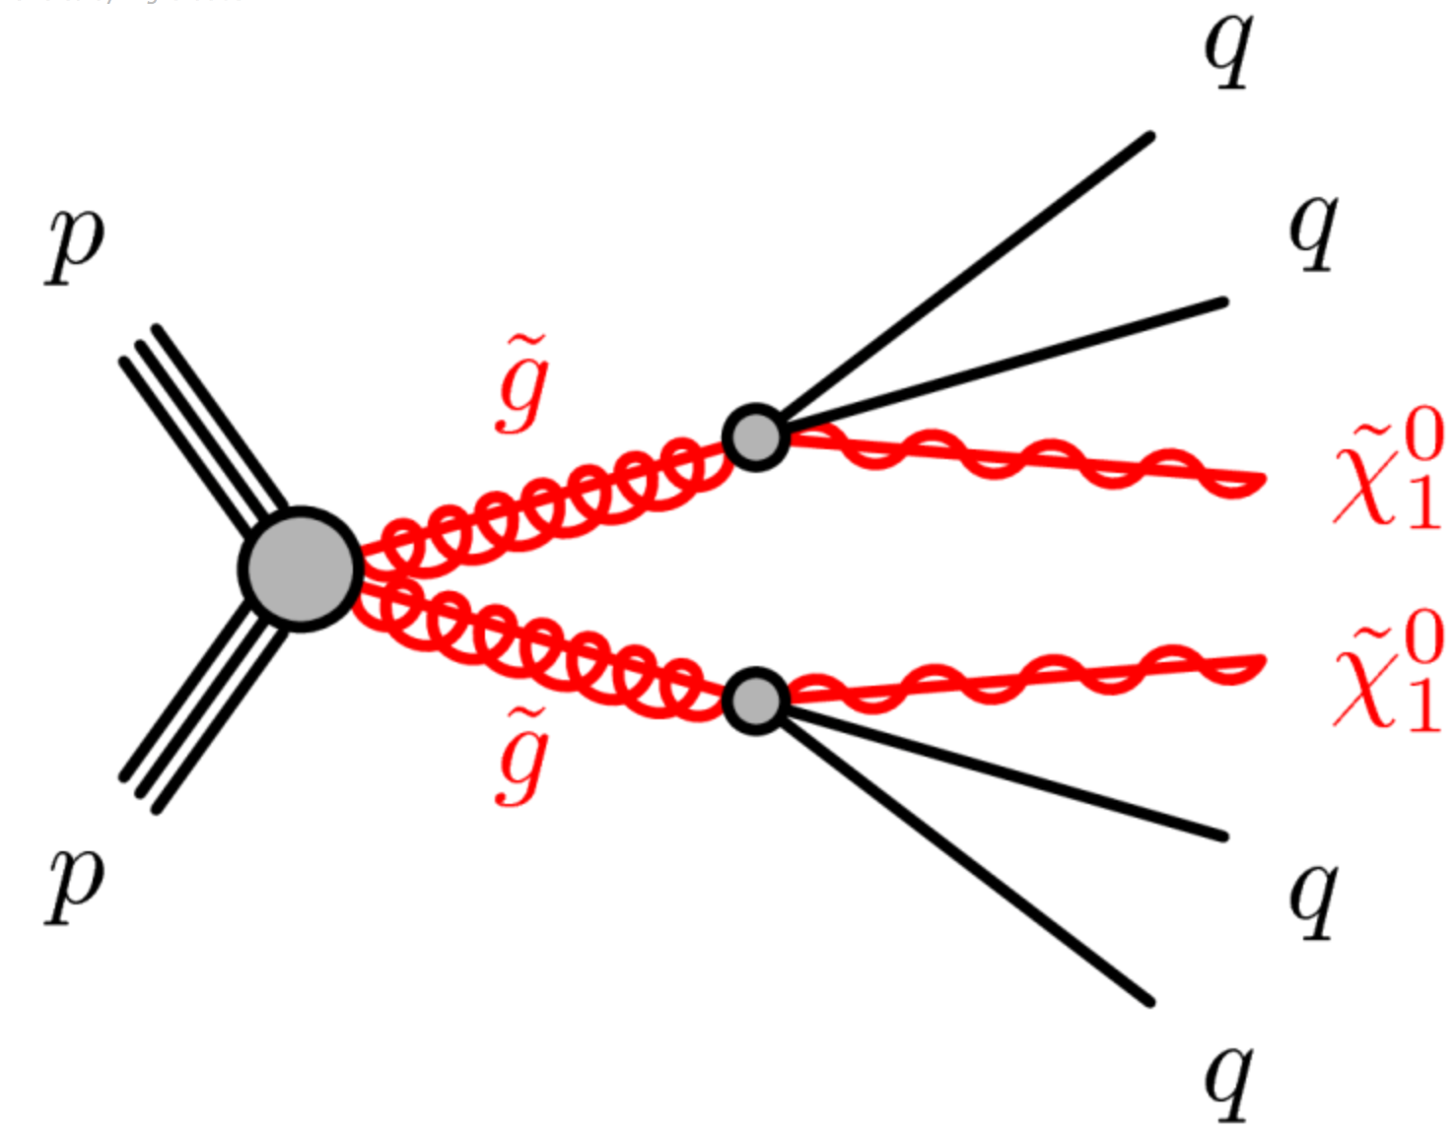
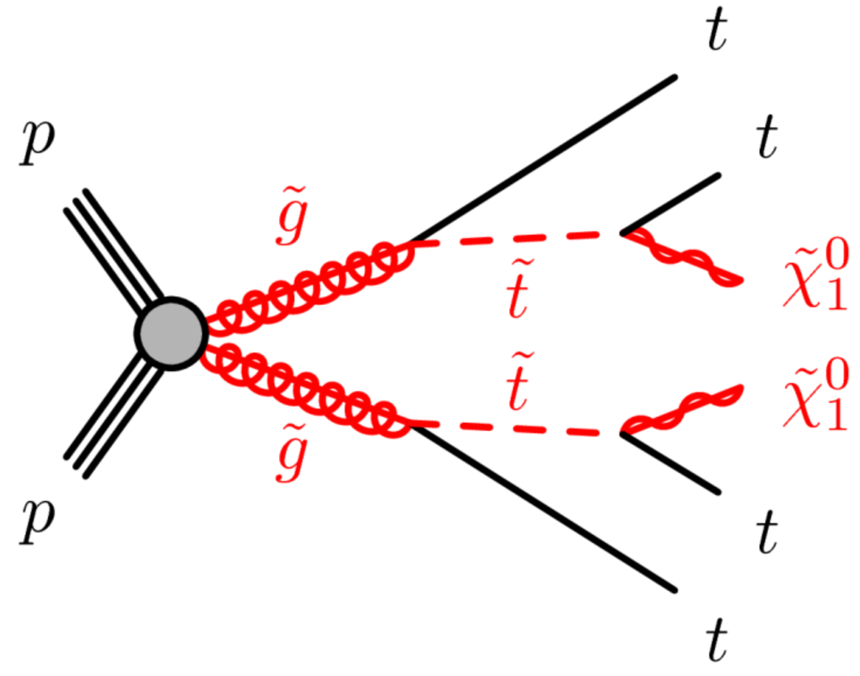

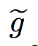
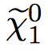


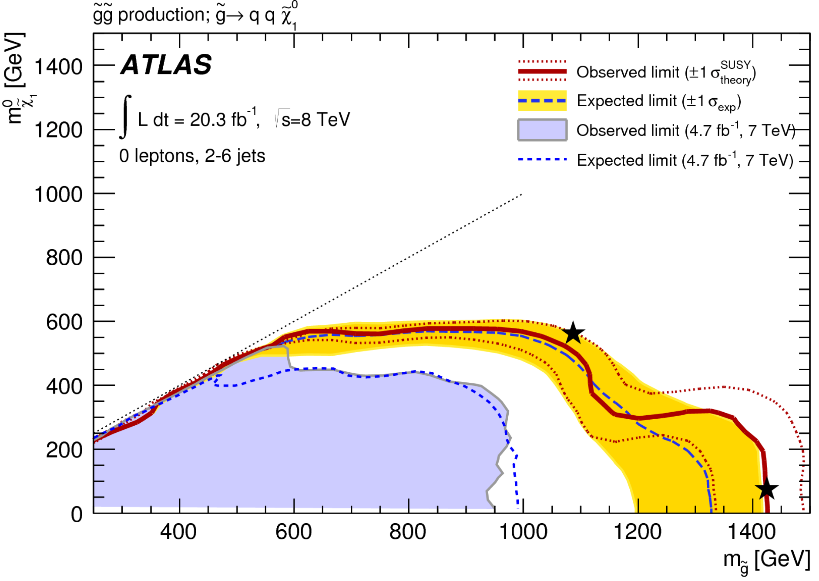
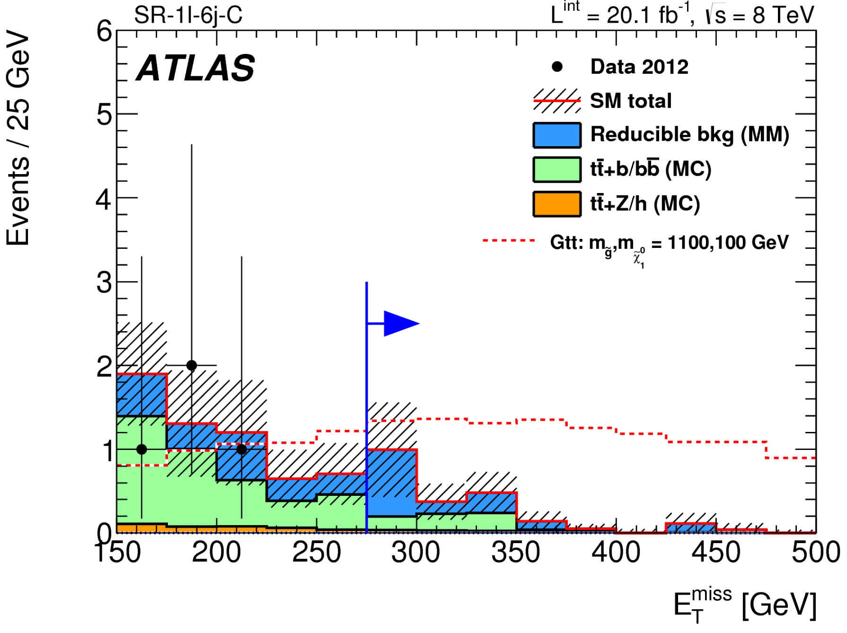


Search For Gluinos (I)
Cross sections of ~1fb for 1 TeV gluinos
The search strategy is tailored to the various possible decay modes
q
t
Final states with jets (2 to >=6), ETmiss, and MEff
SR @ high mass: men > 2.2 TeV
If decay via (virtual) stop, spectacular events with 4 top Ws, 4 bs (0-1L + 3b-jets / 0L / SS leptons + jets + MET)
SR @ high mass: meff > 0.9 TeV
1405.7875
Notes:
Candidate W bosons are reconstructed from single high-mass jets (unresolved candidates – ‘W → j’ in table 2) or from pairs of jets (resolved candidates – ‘W → jj’ in table 2). Resolved candidates are reconstructed using an iterative procedure which assigns each jet to a unique pair with minimum separation ∆R(j,j).
3b: The main source of reducible background is the production of tt ̄ events where a c-jet or
a hadronically decaying τ lepton is mistagged as a b-jet,
The dominant detector-related systematic uncertainties on the amount of irreducible back-
ground are due to the jet energy scale (JES) and resolution (JER) uncertainties; they range
respectively from 16% to 37% and from 1% to 32% in the various SRs before the fit. The

Slide 17







Search For Gluinos (II)
q
1501.03555
Optimal sensitivity achieved by search using 1 lepton, jets, and Etmiss signature
3 classes of signal regions based on lepton pT:
Single Hard Lepton: pT>25 GeV, MEff or ETmiss
Soft Lepton: pT in [6:25] GeV; MEff/ETmiss
Dilepton: pT >14/10 GeV, Razor Variable M’_{R}
Background modeling based on Control Regions
fit to data in bins of Etmiss/meff
Gluino m > 1.2 TeV in most decay modes, for massless LSP
Notes:
two sets of requirements
are optimised for each jet multiplicity: one single-bin signal region optimised for discovery
reach, which is also used to place limits on the visible cross section, and one signal region
which is binned in an appropriate variable in order to exploit the expected shape of the
distribution of signal events when placing model-dependent limits. The binned variables
are: Emiss/mincl in the soft single-lepton regions (four bins of width 0.1),
The theoretical uncertainties related to the tt ̄ background are dominant for all the soft and hard single-lepton signal regions.
it reflects the change in T eff
the Emiss resolution as a function of the calorimeter activity in the event

Slide 18










Search for Squarks
Cross sections similar to those of gluinos
final states with jets (typically smaller multiplicity than for gluinos), Etmiss and leptons if intermediate EWK states
q
1405.7875
8-deg. sq
1-non-deg. sq.
q
1501.03555
Degenerate squark m > 800 GeV for massless LSP

Slide 19






Tagging Squarks: Search for Scharm
c
ATL-PHYS-PUB-2015-001
Scharm could be the lightest squark
Usage of dedicated charm tagger is essential to the search
Looking for displaced D* within a jet
2D selection to reject LF/gluon jets and b-jets
Tagger calibrated in data
scharm m > 550 GeV
for massless LSP
1501.01325
Notes:
The scalar partners (squarks) of various flavours of quarks may, rather generally, have different masses de-spite constraints on quark flavour mixing
Searches for c ̃ states provide not only a possible supersymmetry discovery mode but also the po- tential to probe the flavour structure of the underlying theory.
Jets containing c-flavoured hadrons without b- flavoured parent hadrons are identified using an algo- rithm, optimized for charm tagging, based on a neural network that exploits both impact parameter and sec- ondary vertex information and with a B to D decay chain vertex fitter
tagging efficiency of 19% (13%, 0.5%) is achieved for c-jets (b-jets, light-flavour or gluon jets) in tt ̄ events.
Emiss > 150 GeV and T
one jet with pT > 130GeV

Slide 20

Search for Stop
It typically targets lightest stop
but also searches for heavier stop in gauge mediated SUSY scenarios
Here focusing on models with no light SUSY EWK states

Slide 21










The Stop Master Plot
Search with no-leptons
2 sets of SRs targeting final states with fully-hadronic tops:
6+ jets: 2 resolved tops
4/5+ jets: merged W or top system in large R jets (0.8, 1.2)
Mono-jet search
Charm-tagged search
1406.1122
Stop m > 650 GeV
for massless LSP
Precision measurements as probes for SUSY
re-interpretation of the tt cross section in searches for stop with stop mass ~ top mass
1406.5375
Notes:
Fully resolved: t top candidate with mass m0b j j .
The anti-kt clustering algorithm [74] is applied to R = 0.4 signal jets, using
reclustered distance parameters of R = 0.8 and R = 1.2.
stop 175 GeV 40pb
falling to 20 at 200
t ̃ → tχ ̃0 decay has a right-handed polarisation in 95% of the decays. Due to the slightly more central |η| distribution of the leptons from the subsequent t → Wq, W → lν decay, the preselection efficiency εeμ for these events is typically 10–20 % higher than for SM

Slide 22



Precision measurement of top correlation
Precision measurement of top correlation to probe for stop production
The correlation between the top and anti-top quark spins is measured in dilepton tt events by using the difference in azimuthal angle between the two charged leptons in the lab frame
Measured asymmetry
A = 0.38 ± 0.04 with SM Prediction = 0.318 ± 0.005
Sensitive to stop pair contributions when the stop mass is near the top mass and the stop decays predominantly RH top
1412.4741

Slide 23








Search for EWK SUSY: EWK-inos
Comprehensive program of searches for EWK produced SUSY (charginos, neutralinos, sleptons, staus)
~50 signal regions (with multi leptons or 2 leptons and jets) to achieve best coverage!
Chargino m > 400 GeV if no sleptons
Chargino mass > 700 GeV is sleptons

Slide 24












Higgs bosons as probes for EWK-ino search
Search in events with 1 lepton & 2 b
tt and W+j normalized in control regions
Search in events with 1 lepton & 2 photons
unbinned fit to the diphoton mass distribution
non Higgs bkg from side-band, others from MC
Search in events with 2 same sign leptons
exploit partially reconstructed Higgs mass in mljj

Slide 25

Higgs bosons as probes for EWK-ino search
Search in events with 1 lepton & 2 b
tt and W+j normalized in control regions
Search in events with 1 lepton & 2 photons
unbinned fit to the diphoton mass distribution
non Higgs bkg from side-band, others from MC
Search in events with 2 same sign leptons
exploit partially reconstructed Higgs mass in mljj
1501.07110

Slide 26






Search for EWK SUSY: sleptons
1403.5294
Slepton mass > 340 GeV!
Starting to probe direct staus at hadron collider
1407.0350

Slide 27





Search for R-parity Violation SUSY
Phenomenology driven by R-parity violating couplings
Lepton-number violating decays of LSP probed with search using 4 leptons and MET/Meff and baryon number violating decays with a search for displaced vertices.

Slide 28

Full SUSY Program at ATLAS

Slide 29




The LHC in 2015
Current (A)
Goal for 2015
10980 A: 6.5 TeV
# powering tests
http://hcc.web.cern.ch/hcc/
Notes:
Sector 6-7 and 1-2 are trained to 6.5 TeV
Sectors 5-6 and 8-1 should start soon
(S56 especially interesting because it was trained above 6.5 TeV in 2008)
There will be discussion of an adjustment of the restart schedule in the next days

Slide 30

The LHC in 2015
Current (A)
Goal for 2015
10980 A: 6.5 TeV
# powering tests
http://hcc.web.cern.ch/hcc/
Notes:
Sector 6-7 and 1-2 are trained to 6.5 TeV
Sectors 5-6 and 8-1 should start soon
(S56 especially interesting because it was trained above 6.5 TeV in 2008)
There will be discussion of an adjustment of the restart schedule in the next days

Slide 31

The Future
Run 1
Run 2
Run 3
HL-LHC (Run4, Run5)
~3000/fb
7-8 TeV
13-14 TeV
~300/fb
<μ> ≃ 140
~30/fb
Instantaneous luminosity (1/cm²s)
<μ> ≃ 40
<μ> ≤ 60
Integrated luminosity (1/fb)
<μ> ≤ 21
Phase 1
Phase 2
Notes:
Run2 max inst. 0.8E34

Slide 32









ATLAS Phase 1 Upgrade
Fast Tracker (FTK) for Level-2 Trigger
A dedicated, hardware-based track finder (FTK) is proposed to provide global tracking information after Level-1
Higher Granularity Level-1 Calorimeter Trigger
higher-granularity and longitudinal shower information available to the Level-1 trigger processors
New Small Wheel (NSW)
Level-1 trigger segment reconstruction and matching with angular resolution better than 1mrad
precision tracking up to 7 x 10³⁴/cm²s¹ with spacial resolution better than 100μm
Offline-like reconstruction efficiency
Essential to maintain muon triggers within the allowed bandwidth
Critical to maintain low trigger thresholds for electrons/photons
Notes:
Adapt to challenges of LHC accelerator in all its phases to take full advantage of the LHC physics potential
a number of upgrades of ATLAS are planned
The high instantaneous luminosity expected for the Phase 1 upgrade [5] to the LHC will pose challenges to achieving these goals for the trigger system. Tracking (local and global info) is critical but expensive.
system of electronics, the Fast TracKer or FTK, which will do global track
reconstruction after each level-1 trigger to enable the level-2 trigger to have early access to tracking information.
In the first stage, 8 of the 12 silicon layers are used to perform pattern recognition and do the initial track fitting. Pattern recognition is carried out by a dedicated system called the Associative Memory (AM) [15] which finds track candidates in coarse resolution roads. For each road containing silicon hits on all layers or all except one, the track parameters are calculated using the full resolution hits.

Slide 33







ATLAS Phase 2 Upgrade
New Inner Detector (ITk), 200m2!
Current ID won’t survive beyond 300/fb (Run 3)
New all Si tracker optimized for ~200 PU events
Strip tracker: 5 layers, stubs, 7 disks on each side, |η| < 2.5
Pixel tracker: 4 layers, 6 disks
Expected performance:
14 hits/track for |η| < 2.3
occupancy <1% for μ ~200 with 0.7X₀
New Forward Calorimeter
New Trigger and DAQ architecture
current L1 becomes L0 and new L1 includes precise muon and inner tracking
6/10μs
1MHz
30/60 μs
300/400 kHz
Notes:
The current FCal gap size, designed for operation at peak luminosities of 1034 cm-2 s-1 , is not sufficient to prevent ion build-up in some regions of the FCal at HL-LHC luminosities
A new trigger architecture is being developed that is compatible with the constraints imposed by the detector and provides a flexible trigger with the potential to deliver the required performance.

Slide 34


Extension of ATLAS to large η
Recommendation on upgrade actions to be given in April 2015

Slide 35

The Physics Program at Run 3 and HL-LHC
ATLAS Physics Prospects
Performance assessed using full simulation
Run 2 detector and <μ>=50-80, 300/fb
New tracker (ITK) in Run 1 Calorimeter and Muon system, with varying <μ>
Physics reach (mostly) based on generator level studies with parameterized performance
https://twiki.cern.ch/twiki/bin/view/AtlasPublic/UpgradePhysicsStudies

Slide 36



Vertexing and b-tagging
Long-flat beam might mitigate effects from pile-up
The capability of tagging b-jets critical to the success of the Higgs and BSM programs
High pile-up lead to higher misidentification probability
New tracker recovers Run1 performance!
PLOT-UPGRADE-2014-003
Notes:
ATLAS 1mm
The MV1 algorithm employs an artifical neural network based on IP3D, SV1 and JetFitter
impact parameter (IP3D) and secondary vertex (SV1) to the more refined JetFitter algorithm, which exploits the topology of weak b- and c-hadron decays, using a Kalman filter to search for a common line connecting the primary vertex to beauty and charm decay vertices

Slide 37




Jet Reconstruction and Substructure
Removal of low-pT R=0.3 subjects and pile-up corrections applied to hard-scatter jets with R=1.0 to restore scale and improve energy resolution
Using track based information, pile up jets are discriminated from the hard scatter jets
Z’ in tt
No pile up corrections
Pile up corrections applied
top mass
top mass
Central Only
Charged fraction effective at rejecting pile up jets
Extended

Slide 38





The HL-LHC: a Higgs Factory
Over 100 million SM Higgs bosons in total
access to rare decays like H in μμ and H in Zϒ; assessment of the top Yukawa coupling via ttH production
For example, H into ZZ measured with high purity in the various modes
Large sample allows to probe for CP structure of Higgs
Limits on the CP-even coupling g2 and CP-odd coupling g4
ATL-PHYS-PUB-2013-013
ATL-PHYS-PUB-2013-014

Slide 39







Coupling Precision Measurement
High precision on signal strength achieved by combining various production modes
Measurements of the couplings is interpreted in the leading-order tree level k framework, e.g.:
Significance for Hbb 3.9σ (8.8σ) for 300/fb (3000/fb)
ATL-PHYS-PUB-2014-011
Significance for Hmm 2.3σ (7.0σ) for 300/fb (3000/fb)
ATL-PHYS-PUB-2013-014
ATL-PHYS-PUB-2014-016
Notes:
bosons
fermions
the leading-order tree-level motivated κ-framework is used to project the measurements of Higgs coupling scale factors at the HL-LHC.
CP-even scalar
Some parametrizations make no assumptions on the total width, allowing only mea- surements of ratios λij = κi/κj of coupling scale factors.
A fully generic benchmark parametrization is also used that does not need any assumptions beyond

Slide 40



Mass dependence on Couplings
“Reduced” coupling scale factors yi defined to test the predicted relationship between the Higgs boson couplings and the SM particle masses
ATL-PHYS-PUB-2014-016

Slide 41




Higgs Pair Production in bbγγ at ATLAS
Measurement of the Higgs pair production to probe the trilinear coupling and thus the Higgs potential
Negative interference between the box and s-channel leading to suppression of event yield
bbɣɣ
ATL-PHYS-PUB-2014-019
ATLAS and CMS are discussing the analyses to continue and better understand the remaining differences and explore avenues for sensitivity improvement

Slide 42

Search For Dark Matter

Slide 43



Sensitivity to Dark Matter
Direct search for Dark Matter using mono-jet approach, EFT interpretation
“Higgs portal” models introduce an additional weakly-interacting massive particle (WIMP) as a dark matter candidate
very weakly interacting with the SM particles, except for the Higgs boson
ATLAS BR(Hinv)<0.22 (0.13) with 300/fb (3000/fb)
ATL-PHYS-PUB-2014-007
ATL-PHYS-PUB-2014-017
At the HL-LHC, improvement by for any spin assumption
Discovery potential to M* of 2.5 TeV in 3000/fb if evidence in 300/fb
Notes:
The EFT provides a simple framework to describe WIMP pair production in terms of a contact interaction [4], which is the limiting form of a 2 → 2 body process where the mediator mass, Mmed, is much heavier that the typical scale of the interaction Qtr.
Mmed/ √gSMgDM,
The increase of the centre-of-mass energy leads to stronger limits on M∗ by more than a factor of 2.
This set of coupling values has been confirmed to result in a valid EFT for the full range of M∗ considered in the following discovery potential studies.
Dark Matter operator D5
The expected upper limit on the branching ratio of the Higgs boson to invisible final states, BRi, is derived using the combination of rate measurements. The couplings of the Higgs boson to massive particles other than the WIMP are assumed to be equal to the SM predictions,
total width of the Higgs boson to the SM expectation, Γh/Γh,SM, is parametrized by κh2
The hashed bands indicate the uncertainty resulting from the systematic variation of the form factor fN.
fN = 0.33+0.30 is the form factor associated with the −0.07
Higgs-nucleon coupling, computed using lattice QCD
The exclusions are proportional to the expected limits on BRi (see Eqns. 18–19), so they improve by approximately a factor of 2 with 3000 fb−1 compared to 300 fb−1
with 3000 fb−1 compared to 300 fb−1 if the theory uncertainties are unchanged.
These are spin-independent results obtained directly from searches for nuclei recoils from elastic scattering of WIMPs, rather than being inferred indirectly through Higgs boson exchange in the Higgs portal model.

Slide 44










Discovering and Characterizing Resonances
Significant increase in sensitivity in multi-TeV region relative to Run 1 at √s = 8 TeV
Discovery reach in multi-TeV region benefits the most
Look for a heavy resonances (originating from Z’, KK-excitations) in the tail of the di-lepton invariant mass
HL-LHC essential for model discrimination
Notes:
Separation between spin-1 (Z’) or spin-2 (GKK) interpretation and other
interpretations ranges from ~2 to 5 σ
! 2D likelihood with dilepton angular and rapidity distributions or forward-backward asymmetry

Slide 45

SUSY Reminder

Slide 46



Strong SUSY at the HL-LHC
Significant increase of discovery potential for strongly produced sparticle originates from the increase in center of mass energy (gluino cross-section ~1 fb at 2 TeV)
0L+jets search
PhysicsResultsSUS14012
5σ up to ~2-2.5TeV gluinos
ATL-PHYS-PUB-2014-010
0L+jets search
5σ up to ~3TeV squarks, ~1.2 TeV stops & bottoms
0/1L+jets search
ATL-PHYS-PUB-2013-011

Slide 47



EWK-SUSY at the HL-LHC
Factor 10x in integrated luminosity essential to probe rare SUSY processes, e.g. the pair production of EWK-inos expected to be light from naturalness arguments
EW prod. lower by 2 orders of magnitude but can dominate SUSY production if squarks and gluinos heavy
3L+Etmiss search
ATL-PHYS-PUB-2014-010
5σ up to chargino masses of >800 GeV in explored decay modes
HL-LHC will probe Natural SUSY!
But strong dependence on detector performance

Slide 48
Summary and Outlook
The LHC, ATLAS (and CMS) exhibited a superb performance in Run 1.
One of the prime goals of the LHC, i.e. the discovery of a Higgs boson, has been achieved!
ATLAS is probing the TeV scale in searches for SUSY
with sensitivity to 1 TeV gluinos, 600 GeV stops, 400 GeV EWK-inos.
The High Luminosity upgrade is foreseen to extend from 300 to 3000/fb the dataset collected by the experiments at 14TeV.
Expected good detector performance despite the challenging conditions.
The HL-LHC significantly improves the measurements of Higgs properties and will thus represent an unprecedented probe for high scale New Physics.
The HL-LHC provides discovery potential for natural BSM scenarios.

Slide 49
Additional Material

Slide 50


Inner Tracker (ITK)
ATLAS plans to upgrade a number of sub-detectors including the inner detector (tracker)
Various designs (including extension to high η) are considered for a new all silicon-tracker with high granularity and large bandwidth read-out links
Basic layout is based on:
Strip tracker: 5 layers, stubs, 7 disks on each side, |η| < 2.5
Pixel tracker: 4 layers, 6 disks
Expected performance:
14 hits/track for |η| < 2.3
occupancy <1% for μ ~200
with 0.7X₀ for |η| ≤ 2.7
LHCC-I-023
Notes:
In the central region, sensors are arranged in cylinders, with 4 pixel layers followed by 3 short-strip layers then 2 long-strip layers. From current knowledge of the LHC conditions the outer radius of the beam pipe is assumed to be at 33 mm.
The forward regions will be covered by 6 pixel disks and 7 strip disks. Strip layers are double-sided with axial strip orientation on one side and sensors rotated by 40 mrad on the other side, giving the second coordinate measurement.
he tracker is surrounded by a polyethylene moderator to reduce the energies of neutrons, which decreases the 1MeV neutron equivalent silicon damage fluence arising from the flux of neutrons entering from the calorimeters [44] (which for the current ID are partially moderated by the material of the TRT).
Experience with the current detector indicates that to minimize the number of fake tracks (tracks found by the software
with hits that do not belong to a single particle) at high pile-up requires tracks have at least 11 hits. We have on average 14 (to account for dead modules). Up to 2.7 is important for muons
refers to sx for pT infinite , to remove the contribution due to material.

Slide 51


ITK Strip Detector
Radiation hard sensors
Single sided n⁺-in-p (faster signal, reduced charge trapping)
74.5 um pitch (average in EC)
Barrel
97.54 x 97.54 mm2
inner three layers short strips (23.28 mm)
outer layers long strips (47.75 mm)
EndCap
6 module shapes/sizes
strip length from 8.1 to 49.9 mm
Barrel
Barrel

Slide 52


How can the ANL Group contribute to ITK?
20,000+ modules must be built for a total of 193m²!
My goal at ANL is to join the ITK-strip project and contribute to stave production
ATLAS Kickoff meeting held on Nov 14, 2014
2015
costing exercise for ITK (RRB final report in October 2015)
pre-qualification of production site
2016
finalization of TDR
2016-2018 pre-production
from 2019, production
Notes:
In the central region, sensors are arranged in cylinders, with 4 pixel layers followed by 3 short-strip layers then 2 long-strip layers. From current knowledge of the LHC conditions the outer radius of the beam pipe is assumed to be at 33 mm.
The forward regions will be covered by 6 pixel disks and 7 strip disks. Strip layers are double-sided with axial strip orientation on one side and sensors rotated by 40 mrad on the other side, giving the second coordinate measurement.
he tracker is surrounded by a polyethylene moderator to reduce the energies of neutrons, which decreases the 1MeV neutron equivalent silicon damage fluence arising from the flux of neutrons entering from the calorimeters [44] (which for the current ID are partially moderated by the material of the TRT).
Experience with the current detector indicates that to minimize the number of fake tracks (tracks found by the software
with hits that do not belong to a single particle) at high pile-up requires tracks have at least 11 hits. We have on average 14 (to account for dead modules). Up to 2.7 is important for muons
refers to sx for pT infinite , to remove the contribution due to material.

Slide 53



Approximate Estimate of Resources
Clean Rooms ~6000 SF or class 10,000 (or better)
General lab space ~1000 SF
burn in capabilities; bench top equipment; water glycol chillers
Cubicle and Office space
large area for visitors (~20 people), meeting rooms, rooms for social/professional breaks
Facility supplies general services (compressed air, dry compressed air, nitrogen, vacuum…)
Assuming 3000 modules in 2-3 years (10 modules per day), personnel needed for QC, assembly, QA:
Core technicians (see table)
~2 FTEs Core Engineer Physicists
Postdocs, graduate students, designers
(Local) ~1 FTE Project Leader
Cost of basic setup
for first pre-production test

Slide 54


Phase I : New Small Wheel
Muon Small Wheel is located between EC-calo and EC-toroid
in high luminosity condition, background rate exceeds ~15 kHz and tracking performance deteriorates
New Small Wheel (NSW) is based on a two-chamber technology:
Small gap chamber (sTGC): primary trigger
MicroMega (MM): primary tracker
Expected performance:
Level-1 trigger segment reconstruction and matching with angular resolution better than 1mrad
precision tracking up to 7 x 10³⁴/cm²s¹ with spacial resolution better than 100μm
ATLAS-TDR-020
Notes:
The barrel system covers the η region of |η| < 1.0 whereas the end-cap system covers the 1.0 < |η| < 2.7 for muon tracking and 1.0 < |η| < 2.4 for Level-1 trigger
The η coverage of the proposed NSW (and the existing Small Wheel) is 1.3 < |η| < 2.7.
TGC single bunch crossing identification capability.
MM detectors have exceptional precision tracking capabilities due to their small gap (5 mm) and strip pitch (approximately 0.5 mm).
(latency TGC now 1us)

Slide 55
Phase I : Fast Tracker Trigger (FTK)
Under high luminosity conditions, extensive tracking is expensive in terms of processing time per event or computing cores needed
A dedicated, hardware-based track finder (FTK) is proposed to provide global tracking information after Level-1 trigger FTK:
receives the hits at full rate following a Level-1 accept
computes the helix parameters:
Associative Memory finds track candidates in coarse resolution ‘roads’ using pre-loaded patterns and information from 8/12 silicon layers
A full l2-layer fit is carried out for good tracks outputting hits on the track, track χ², helix parameters, track quality word
operates at 100 kHz, with latency compatible with Level-2 (<100μs)
ATLAS-TDR-021
Notes:
The most relevant efficiency measure for FTK is the relative efficiency with respect to tracks found by the offline tracking algorithm.

Slide 56



Phase 1 : Liquid Argon Calorimeter Trigger
The Run 1 Level-1 calorimeter trigger input was based on ΔηxΔφ=0.1x0.1 ‘towers’
Used to compute object energy and isolation
Leading to triggers rate ~ 270kHz @ 3x10³⁴cm⁻²s⁻¹
The upgrade will make higher-granularity and longitudinal shower information available to the Level-1 trigger processors, expected improvement of energy resolution and object identification efficiency
Run 1
Phase I
ATLAS-TDR-022

Slide 57

Phase II : Forward Calorimeter
Current FCAL consists of 3 modules with FCAL1 closest to the interaction point
as luminosity increases, performance degrades due to space charge effects, HV drop and possibly heating up of the liquid argon.
Two options (three when including no upgrade)
new sFCAL
has same design, smaller LAr gaps, new summing boards; requires cooling down of the cryostat
additional miniFCAL in front of the FCAL
3 technologies are explored: diamond, High Pressure Xenon gas, and liquid argon
planned to use copper absorber
impact on the cryostat is limited but modification to the beam pipe is required
LHCC-I-023
Notes:
with smaller liquid argon gaps in order to fend off space-charge limitations.

Slide 58

Phase II : Trigger System
HL-LHC will provide Linst of 5-7 x10³⁴ 1/cm² s
To maintain low thresholds, a new trigger system is proposed with a 2-step first level hardware trigger:
1st step, Level-0: calorimeter and muon information (functionally the same as the Phase I Level-1)
2nd step, Level-1: regional tracking information, regional full calorimeter granularity, refined muon selection using muon precision tracking chambers
within latency, processing time available to further refine EM, tau, jet and energy sum trigger objects.
Offline-like algorithms will be used at the High-Level Trigger (software) with a readout rate of 5-10 kHz
6/10μs
1MHz
30/60 μs
300/400 kHz
LHCC-I-023
Notes:
From the FTK TDR p122: For Phase-II the L1Track trigger system will be installed. It is expected to do tracking in regions of interest covering an average of ∼10% of the detector phase space in an event and to have a higher pT threshold, perhaps 5-10 GeV
This mandates the replacement of the detector readout electronics to accommodate the new two-step Level-0/Level-1 architecture: the higher trigger accept rates and the extended latencies at both Level-0 and Level-1.

Slide 59

Run 1 b-tagging
https://atlas.web.cern.ch/Atlas/GROUPS/PHYSICS/CONFNOTES/ATLAS-CONF-2014-046/fig_01.png

Slide 60


Slide 61


Slide 62

Higgs : Dark Matter Portal

Slide 63

SUSY Full Spectrum (pMSSM)

Slide 64


Razor
Exploit the symmetry in the visible portion of sparticle decays when sparticles are produced in pairs. The final-state jets and leptons are grouped into two “mega-jets”

Slide 65

Trimming
Contamination from pile-up, multiple parton interactions (MPI) and initial-state radiation (ISR) in the reconstructed jet is often much softer than the outgoing partons associated with the hard-scatter and their final-state radiation (FSR)
The ratio of the pT of the constituents to that of the jet is used as a selection criterion
The trimming procedure uses a kt algorithm to create subjets of size Rsub from the constituents of a jet.
Any subjets with pTi/pjet < fcut are removed

Slide 66


PU Observables

Slide 67

Precision Frontier at electron-positron colliders
Notes:
model independent extraction of gZZH from σZH in fit to recoil mass spectrum!
other Higgs couplings extracted from σZH x BR measurements and gZZH!
total width extracted from combination of initial and final state measurements!

Slide 68

Precision Frontier at electron-positron colliders
Notes:
model independent extraction of gZZH from σZH in fit to recoil mass spectrum!
other Higgs couplings extracted from σZH x BR measurements and gZZH!
total width extracted from combination of initial and final state measurements!

